Slide 1
MEDICAL MANAGEMENT OF POSTPARTUM HAEMORRHAGE

Slide 2
MEDICAL TREATMENT
H: Help.
A: Assess and Resuscitate.
E: Etiology ( 4“T” ).
M: Massage uterus.
O: Oxytocin infusion (Ergometrine, PG).
S: Shift to operating room.
T: Tamponade ballon or uterine packing.
A: Apply compression sutures.
S: Systematic pelvic devascularization.
I: Intervention radiologist: UAE.
S: Subtotal or Total abdominal hysterectomy.
Lalonde A, Daviss B.A, Herschderfer K, Acosta A, Postpartum haemorrhage today: ICM/FIGO initiative 2004 -2006. Inter J Gynecol & Obst. Vol 94 Issue 3. 2006

Slide 3
THE GOLDEN HOUR
Survival odds are related to the severity and the duration of haemorrhagic shock
STASIS
HAEMO
Lalonde A, Daviss BA, Acosta A, Herschderfer K. Postpartum hemorrhage today: ICM/FIGO initiative 2004-2006
. Int J Gynaecol Obstet. 2006 Sep;94(3):243-53. Epub 2006 Jul 12.

Slide 4
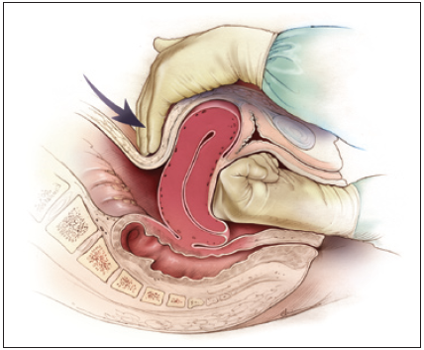
TREATMENT: MASSAGE AND OXYTOXICS 20 MINUTES
Image taken from http://www.aafp.org/afp/2007/0315/p875.html

Slide 5
RICHTLIJN SU
Stap 1: Bolus oxytocine 10 IE i.m. herhalen (eventueel 10 IE i.v. langzaam in 2 minuten, cave: tijdrovend!)
Stap 2: Oxytocine 10 IE in kolf NaCl 0.9% à 4 uur (2.5 IE / uur in 500cc = 40-45 druppels / min). Minimaal 4 uur continueren, daarna op geleide van de kliniek.
Volgende stappen mits placenta geboren is:
Stap 3: Methergine 0.2mg i.m. (pas op bij relatieve contra-indicatie: PIH / pre-eclampsie)
Stap 4: Misoprostol 400-800 mcg rectaal

Slide 6
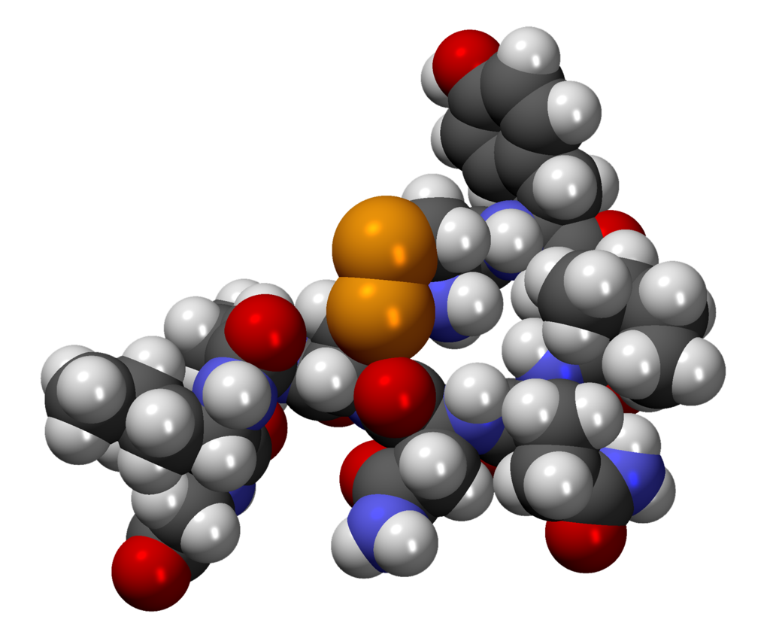
OXYTOXICS: FIRST LINE
OXYTOCIN
9 aa. Hormone ( nona peptide)
Rythmic contraction of smooth muscle and myoepithelial cells
Short half life: 5 minutes
Onset of action: 2 to 3 minutes (I.M.)
instantaneaously / 1 min (I.V)
Continuous infusion
Residual effect up to one hour after the infusion
SOGC Active Management of the Third Stage of Labour: Prevention and Treatment of Postpartum Hemorrhage. J Obstet Gynaecol Can 2009;31(10):980–993
Bohlmann MK, Rath W. Medical prevention and treatment of postpartum hemorrhage: a comparison of different guidelines. Arch Gynecol Obstet. 2014 Mar;289(3):555-67.

Slide 7
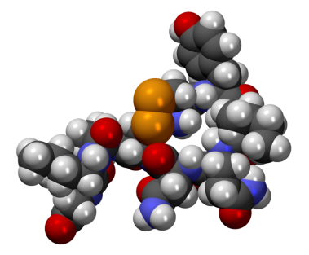
OXYTOXICS: FIRST LINE
Rapid IV administration (less than 1 minute):
Vasodilation
Hypotension
Tachycardia
Arrhythmias
ST-depression
High dosages:
Free water retention
Hyponatremia
Pulmonary oedema
http://pubchem.ncb|i.nlm.nih.gov/image

Slide 8
TREATMENT REGIMENS: OXYTOCIN
Clinical Practice Guidelines | Dosages
SOGC. Prevention and Treatment of Postpartum Hemorrhage. J Obstet Gynaecol Can 2009;31(10):980–993 | 10 IU IM 5-10 IU IV (1-2 min) 20-40 UI/L to 150mL/h
RCOG Green-top Guideline No. 52. Nov. 2009 | 5 IU IV (1-2 min) 80 UI/L to 125 mL/h
Prevention and treatment of postpartum hemorrhage in low-resource settings. FIGO. Int J Gynaecol Obstet. 2012 May;117(2):108-18. | 10 IU IM 5 IU slow bolus 40-80 UI/L to 60 mL/h 20 UI/L to 40 ml/h
World Health Organization. WHO guidelines for the prevention and treatment of postpartum haemorrhage. Geneve: WHO Press; 2012 | Intravenous administration
Minsalud Colombia. Guía de práctica clínica para la prevención y el manejo de la hemorragia posparto y complicaciones del choque hemorrágico. Rev Colomb Obstet Ginecol . 2013 Dec; 64(4): 425-452 | 5 IU IV (3 min) 60 UI/L to 125 mL/h
SOGC Intramyometrial administration: 10 IU if bleeding persists

Slide 9
TREATMENT REGIMENS HOSPITALS SU
 | Ziekenhuis
 | A | B | C | D
Stap 1 (preventief) Stap 2 Stap 3 Stap 4 | Actief NGT: Oxytocine 5-10 IE im Oxytocine 5 IE im (2x) Oxytocine in kolf: 10 IE / 4u druppel/perfussor (500cc NaCL 0.9%) Misoprostol 600mcg rectaal | Geen actief NGT Oxytocine 5-10 IE im / iv - Misoprostol 600mcg rectaal | Meestal actief NGT: Oxy 10 IE im Oxytocine 10 IE im Oxytocine 5 IE iv + 5 IE in kolf (500cc NaCL 0.9%) Misoprostol 400mcg rectaal | Geen actief NGT Oxytocine 5 IE iv of 10 IE im Tot 30-40 IE oxy totaal - Misoprostol 600mcg rectaal

Slide 10
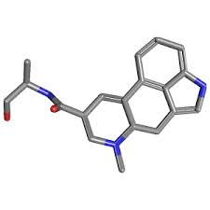
OXYTOCICS: SECOND LINE
ERGOMETRINE
0.2 mg/mL – Intramuscular
Rye ergot derivatives
Myometrial receptors
α-adrenergics
Rhythmic and tetanic contractions
Half life: 0.5 to 2 hours
Peak concentration: 20 minutes
Onset of action: 2-3 min
http://pubchem.ncbi.nlm.nih.gov/summary/summary.cgi?cid=443884&|loc=ec_rcs
Bohlmann MK, Rath W. Medical prevention and treatment of postpartum hemorrhage: a comparison of different guidelines. Arch Gynecol Obstet. 2014 Mar;289(3):555-67
RCOG Green-top Guideline No. 52. Nov. 2009
Guía de práctica clínica para la prevención y el manejo de la hemorragia posparto y complicaciones del choque hemorrágico. Rev Colomb Obstet Ginecol . 2013 Dec; 64(4): 425-452.

Slide 11
OXYTOCICS: SECOND LINE
JARR 2014
Second dosage after 20 minutes.
Repeat every 4-6 hours up to a total maximal dose of 5 vials in 24 hours
Intramyometrial administration: 0.125 mg.
Persistence of haemorrhage
“Off Label”: as judged by physician and under his/her responsibility

Slide 12
OXYTOXICS: SECOND LINE
JARR 2014
Contraindications:
Hypertension
Pre-eclampsia
Heart diseases*
HIV
Adverse effects:
Nausea
Vomiting
Vasospasm
Hypertensive encephalopathy
Brain ischaemia
Myocardial ischaemia*.
Ischaemia of limbs.
Maternal death*.

Slide 13
TREATMENT REGIMENS: ERGOMETRINE
Clinical Practice Guideline | Dosages
SOGC. Prevention and Treatment of Postpartum Hemorrhage. J Obstet Gynaecol Can 2009;31(10):980–993 | 0.25 mg IM
RCOG Green-top Guideline No. 52. Nov. 2009 | 0.5 mg IM **
Prevention and treatment of postpartum hemorrhage in low-resource settings. FIGO. Int J Gynaecol Obstet. 2012 May;117(2):108-18. | 0.2 mg IM c/4-6 h Maximum: 1 mg /24h
World Health Organization. WHO guidelines for the prevention and treatment of postpartum haemorrhage. Geneva: WHO Press; 2012 | 0.2 mg IM (0- 15 min-c/4 h) Maximum: 1 mg /24h
Minsalud Colombia. Guía de práctica clínica para la prevención y el manejo de la hemorragia posparto y complicaciones del choque hemorrágico. Rev Colomb Obstet Ginecol . 2013 Dec; 64(4): 425-452 | 0.2 mg IM (0- 20 min-c/4 – 6 h) Maximum: 1 mg /24h

Slide 14
OXYTOCICS: PROSTAGLANDINS
MISOPROSTOL
PGE1 analogues
binds to myometrial cells to cause strong myometrial contractions leading to expulsion of tissue
Adverse effects PG-s:
Nausea, vomiting, diarrhea, headaches, fever, tremor, tachycardia, hypertension, bronchospasm.
Oral or Sublingual:
Onset of action: 7 -11 min
Peak: 30 min
Duration: 120 – 180 min
Greater absorption and more side effects
Rectal:
Onset of action: 20 min
Peak: 60 min
Duration: 30 min - 4 hours
Longer duration with lower incidence of fever.
Michael A Belfort, Management of postpartum hemorrhage at vaginal delivery. http: www.uptodate.com: updated April 4 2014.

Slide 15
OXYTOCICS: PROSTAGLANDINS
Misoprostol 600-1000 ug added to the traditional uterotonic management vs placebo :
Maternal mortality: (RR) 6.16, IC 95% 0.75 - 50.85),
Severe maternal morbidity: (RR 0.34, IC 95% 0.01 - 8.31),
Admission to ICU: (RR 0.79, IC 95% 0.30 - 2.11)
Hysterectomy: (RR 0.93, , IC 95% 0.16 - 5.41)
Misoprostol 800 ug SL vs infusion of oxytocin (40IU/L) as primary therapy
Loss over 1000 mL: (RR 2.65, IC 95% 1.04 – 6.75)
Trasfusion: (RR 1.47, IC 95% 1.02 – 2.14)
Bleeding mean (mL): (MD 44.86, IC 95% 26.50- 63.22)
Vomiting : (RR 2.52, IC 95% 1.45 - 4.38)
Shivering: (RR 2.70, IC 95% 2.28 - 3.19)
No differences in fainting, fever over 38°C and fever over 40°C.
Winikoff B, Dabash R, Durocher J, Darwish E, Nguyen TN, León W, Raghavan S, Medhat I, Huynh TK, Barrera G, Blum J.Treatment of post-partum haemorrhage with sublingual misoprostol versus oxytocin in women not exposed to oxytocin during labour: a double-blind, randomised, non-inferiority trial. Lancet. 2010 Jan 16;375(9710):210-6
Mousa HA, Blum J, Abou El Senoun G, Shakur H, Alfirevic Z Treatment for primary postpartum haemorrhage.
Cochrane Database Syst Rev. 2014 Feb 13;2:CD003249

Slide 16
Misoprostol heeft geen bewezen toegevoegde waarde als het gegeven wordt naast het bovenstaande oxytocine beleid.
Misoprostol kan als alternatief gegeven worden indien oxytocine niet beschikbaar is en de placenta reeds geboren is.

Slide 17
TREATMENT REGIMENS: MISOPROSTOL
Clinical Practice Guideline | Dosages
SOGC. Prevention and Treatment of Postpartum Hemorrhage. J Obstet Gynaecol Can 2009;31(10):980–993 | 400-800 ug SL-VO 800-1000 ug VR
RCOG Green-top Guideline No. 52. Nov. 2009 | 600 ug VO 1000 ug VR
Prevention and treatment of postpartum hemorrhage in low-resource settings. FIGO. Int J Gynaecol Obstet. 2012 May;117(2):108-18. | 800 ug SL Only of oxytocin is NA or fails
World Health Organization. WHO guidelines for the prevention and treatment of postpartum haemorrhage. Geneve: WHO Press; 2012 | 800 ug SL Only of oxytocin is NA or fails.
Minsalud Colombia. Guía de práctica clínica para la prevención y el manejo de la hemorragia posparto y complicaciones del choque hemorrágico. Rev Colomb Obstet Ginecol. 2013 Dec; 64(4): 425-452 | 800 ug SL Only of oxytocin is NA or fails.
Uso simultáneo: SDS. Guías atención materna. ISBN 958-8069-73-4.2009.

Slide 18
TRANEXAMIC ACID
Anti-fibrinolytic agent:
Effective in abnormal uterine bleeding
Extrapolation from trauma studies
WOMAN TRIAL
Tranexamic acid is a synthetic analog of the amino acid lysine. It serves as an antifibrinolytic by reversibly binding four to five lysine receptor sites on plasminogen. This prevents plasmin (antiplasmin) from binding to and degrading fibrin and preserves the framework of fibrin's matrix structure.
Adverse effects:
Nausea, vomiting, diarrhea, blurry vision
Hypotension, renal and retinal thrombosis
Gai MY et al. Clinical observation of blood loss reduced by tranexamic acid during and after caesarian section: a multi-center, randomized trial. European Journal of Obstetrics, Gynecology, and Reproductive Biology, 2004, 112(2):154–157.39.
As AK, Hagen P, Webb JB. Tranexamic acid inAs AK, Hagen P, Webb JB. Tranexamic acid in the management of postpartum haemorrhage. British Journal of Obstetrics and Gynaecology, 1996, 103(12):1250–1251.
Mousa HA, Blum J, Abou El Senoun G, Shakur H, Alfirevic Z Treatment for primary postpartum haemorrhage. Cochrane Database Syst Rev. 2014 Feb 13;2:CD003249

Slide 20
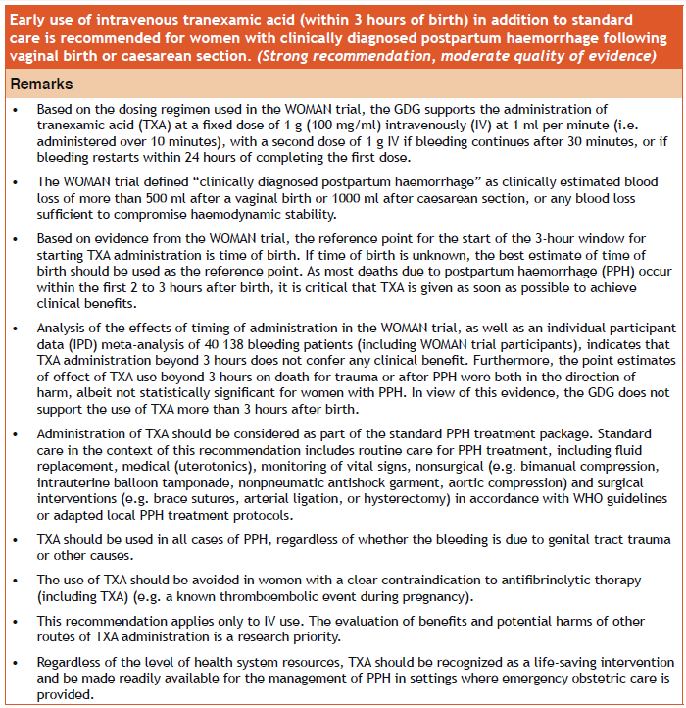

Slide 21
Tranexamic acid
Toedienen bij fluxus postpartum of ongoing bloedverlies (en shock)
Moet onderdeel worden van de standard behandeling van PPH
Binnen 3 uren na geboorte toedienen
Dosis : 1 gr i.v ( 100 mg/ml in 10 min), indien na 30 min nog bloedverlies nog 1 gr i.v.

